Slide 1
Mini Project Road Map
Atharva Karekar

Slide 2
Numpy
Definition: What is NumPy?
NumPy, short for Numerical Python, is an open-source numerical computing library for the Python programming language. It provides support for large, multi-dimensional arrays and matrices, along with a collection of mathematical functions to operate on these arrays. NumPy is a fundamental package for scientific computing in Python, facilitating efficient data manipulation, mathematical operations, and integration with other data science and machine learning tools.
Integration with Other Libraries: NumPy serves as a foundational building block for many other scientific and data analysis libraries in Python, such as SciPy, pandas, and scikit-learn. It provides a common data structure that facilitates interoperability between these libraries.
Performance: NumPy is implemented in C and Fortran, making it significantly faster than traditional Python lists for numerical operations. This performance improvement is crucial when working with large datasets and computationally intensive tasks.

Slide 3
Features of Numpy
Data Types and Attributes
Universal Functions (ufuncs)
Indexing and Slicing
Linear Algebra with NumPy
Solving linear equations using NumPy
Random in NumPy
Performance Optimization
NumPy and Data Science

Slide 4
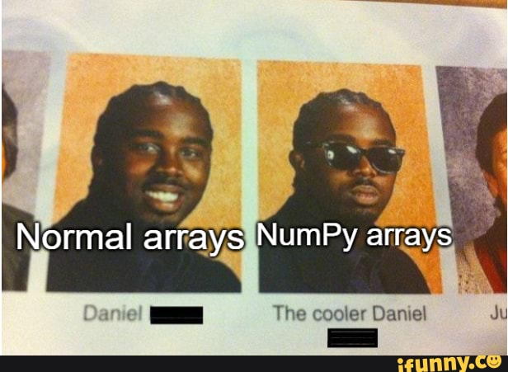
Arrays of Numpy

Slide 5
Arrays In Numpy
NumPy Arrays:
Basics of NumPy arrays: Creating arrays, array indexing, and slicing.
Array operations: Mathematical operations, element-wise operations, and broadcasting.
Array Manipulation:
Reshaping arrays:
Changing the shape and dimensions.
Stacking and splitting arrays.
Adding and removing elements.
Indexing and Slicing
Advanced indexing techniques:
Boolean indexing, fancy indexing. Slicing arrays for extracting specific portions of data.

Slide 6
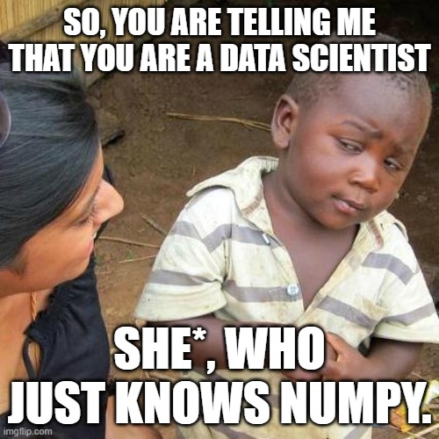
Let’s Know More

Slide 7
Pandas
Why Pandas ?
Pandas is a popular open-source data manipulation and analysis library for the Python programming language. It provides data structures and functions necessary to efficiently manipulate large datasets and perform various data analysis tasks.

Slide 8
Features of Pandas
DataFrame and Series:
Labeling:Versatility:
Indexing and Selection:
Data Alignment:
Data Cleaning Tools:
Data Manipulation:
Statistical Operations:
Data Visualization:

Slide 9

ohhh

Slide 10
Features of Pandas
Input/Output Functions:
Time Series Functionality:
Flexible Hierarchical Indexing:
Wide Range of Operations:
Open-source and Community Support:
Documentation and Learning Resources:

Slide 11

Differences

Slide 12
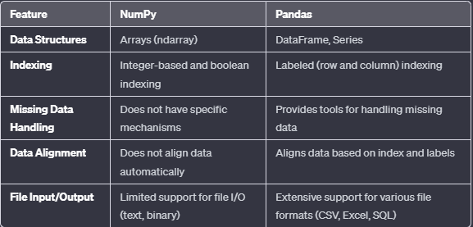
Difference Between Numpy and Pandas

Slide 13
Matplotlib
Why Matplotlib?
Matplotlib is indeed a versatile data visualization library that caters to a wide range of plotting needs in Python. Whether you need simple line charts, scatter plots, bar graphs, or more complex visualizations, Matplotlib provides a comprehensive set of tools for creating static, interactive, and animated plots. Its flexibility, customization options, and integration with other Python libraries make it a valuable tool for data scientists, analysts, researchers, and anyone working with data in Python.

Slide 14
Features of Matplotlib
Comprehensive Plotting Capabilities:
Flexibility and Customization:
Integration with Jupyter Notebooks:
Matplotlib's Pyplot Interface:
Support for Multiple Backends:
Large and Active Community:
Matplotlib Gallery:
Mature and Stable:
Integration with Other Libraries:

Slide 15
Lets Conclude
Today's lecture explored essential tools for data manipulation and visualization in Python: NumPy, Pandas, and Matplotlib.
NumPy, as the foundational library for numerical computing, facilitates efficient handling of arrays and matrices, enabling seamless mathematical operations.
Pandas, a robust data manipulation library, introduces versatile structures like DataFrame and Series, simplifying tasks such as data cleaning, indexing, and aggregation.
Matplotlib, a versatile plotting library, empowers users to create static, interactive, and animated visualizations with extensive customization options.
Matplotlib seamlessly integrates with Jupyter Notebooks and supports multiple backends, providing flexibility in various environments.
Together, NumPy, Pandas, and Matplotlib form a powerful trio, equipping practitioners with tools to tackle complex data tasks and gain meaningful insights.
Practical exercises, documentation exploration, and engagement with the Python data science community are encouraged for continuous learning and collaboration.

Slide 16
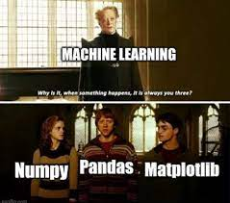
Overall

Slide 17
I got you Covered
https://github.com/Atharvakarekar/ML-Basics.git

Slide 18
Thank you !!

